Slide 1
The value of punctuation

Slide 2
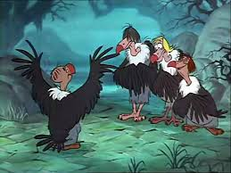
Let’s eat, grandad!
Let’s eat grandad!

Slide 3
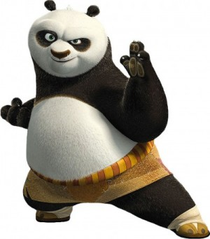
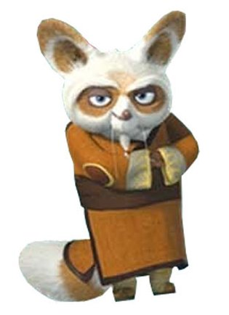
Kung Fu punctuation
Warning: Not for faint hearted

Slide 4
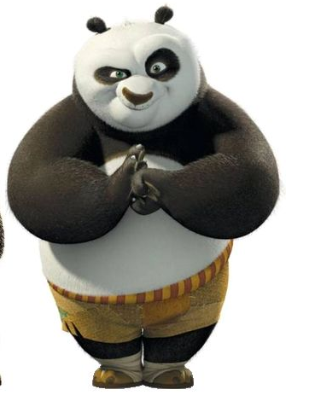
Capital Letter
(and proper nouns)
First rule of Kung Fu – Bow to opponent

Slide 5

Full Stop
Throw a short, right-handed punch at the air in front of you.
Make the noise, Ha!

Slide 6
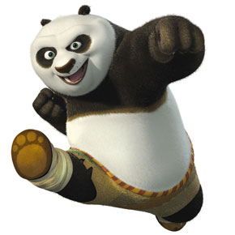
Full stop . (HA!)

Slide 7

Comma
With your right arm bent so that your hand is in front of your face, make a short twisting motion at the wrist to signify the comma shape. Make the noise, She!

Slide 8
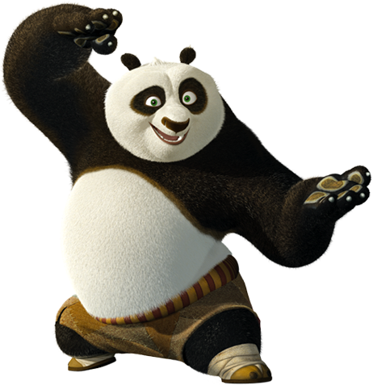
Comma , (She!)

Slide 9

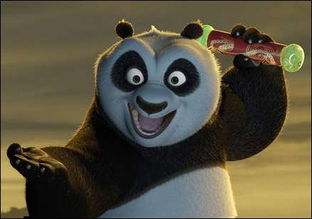
Question Mark
Separate the curly bit into three cutting movements with the hand: one horizontal left to right, one curved around, and one vertical coming from the bottom of the curved one. Then at the bottom of the shape you have just drawn in the air, bung in a full-stop punch.
Make the noises, She! She! She! Ha!

Slide 10
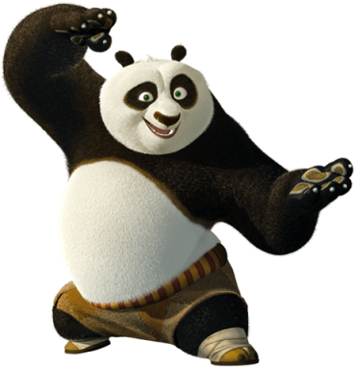

Question Mark ?
She!
She!
She!
HA!

Slide 11
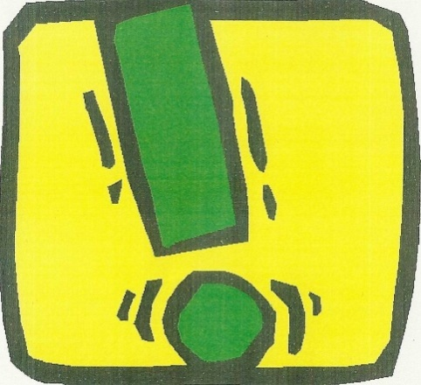
Exclamation Mark
A long vertical slash, from top to bottom, followed by a full stop.
Make the noises, Sheeeeeee! Ha!

Slide 12
Exclamation mark !
Sheeeeeeeee!
HA!

Slide 13

Apostrophe
With your right arm fully extended to the air, wiggle your index finger. Make the noise, Blubalubaluba! (This is the best I can do to approximate the sound you can make with your tongue when you flap it up and down against the inside of your lips.)

Slide 14
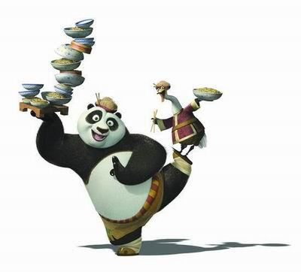
Apostrophe
(Tickle here)

Slide 15
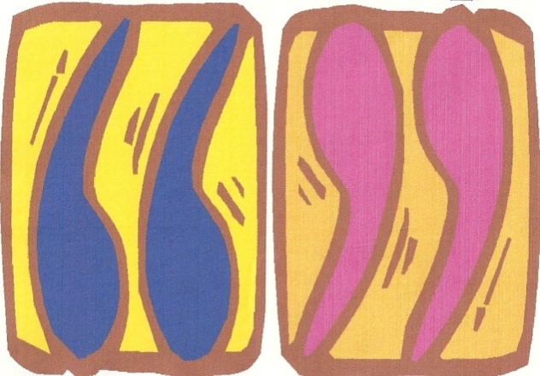
Speech Marks
Stand on one leg, extend your arms diagonally to the skies and wiggle your index and middle fingers in an approximation of speech marks.
Make the noise, Haaaaaaaaaai!

Slide 16
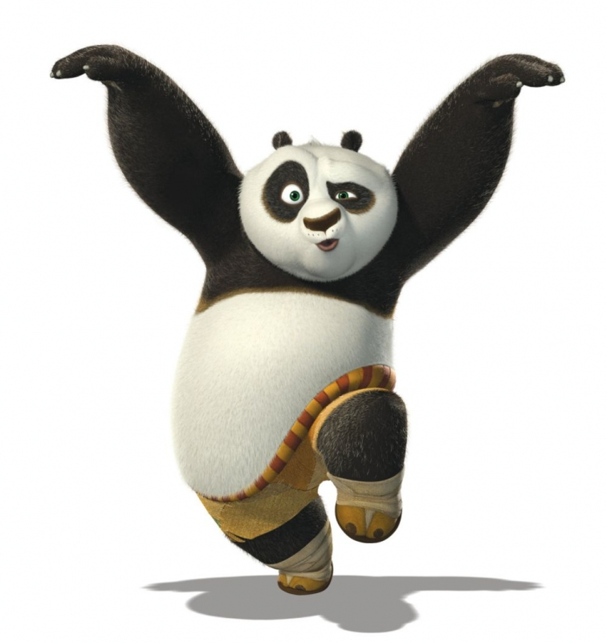
Speech marks “...” (Haaaaai)

Slide 17

Semi-Colon
Do the full-stop punch, then the comma shape directly underneath it. Make the noises, Ha! She!

Slide 18
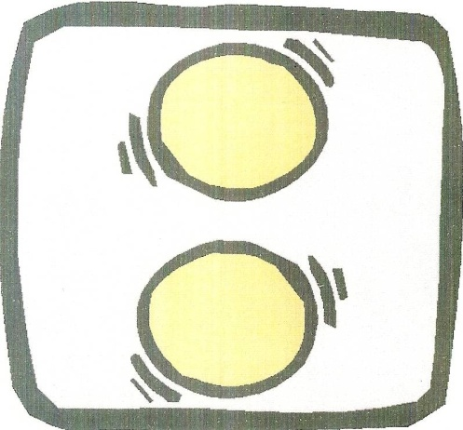
Colon
Follow the full-stop punch immediately with one directly beneath it. Make the noises, Ha! Ha!

Slide 19
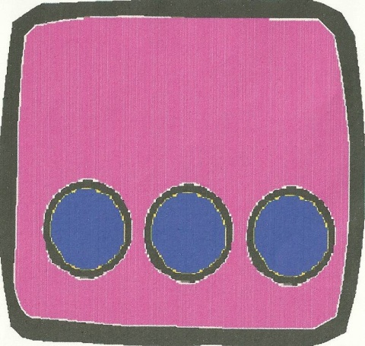
Ellipsis
Three punches along a horizontal line. Make the noises, Ha! Ha! Ha!

Slide 20
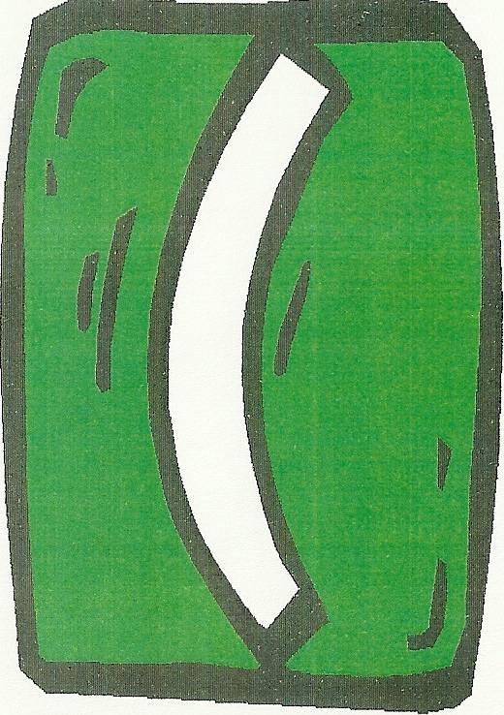
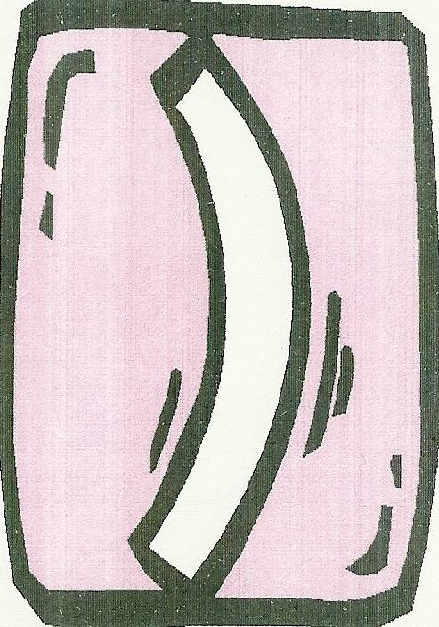
Brackets
Using your left hand first, draw a curved convex line in the air; use your right hand to do the opposite motion for the closing bracket.
Make the noises, She! She!

Slide 21
Kung Fu punctuation
Capital Letter
(start of a sentence)
–
– Bow to opponent
EXAMPLE:
A

Slide 22
Kung Fu punctuation
Capital Letter
(start of a sentence)
–
– Bow to opponent
EXAMPLE:
T

Slide 23
Kung Fu punctuation
Proper Noun
–
– Bow to opponent
EXAMPLE:
July

Slide 24
Kung Fu punctuation
Proper Noun
–
– Bow to opponent
EXAMPLE:
Monday

Slide 25
Kung Fu punctuation
Because you`re special!
–
– Bow to opponent
EXAMPLE:
I
Notes:
Yes, I know “I” is a subject pronoun, but it’s the only subject pronoun that is capitalised and was first introduced in the 15th century. However it wasn’t widely accepted until the 17th century. If you’d prefer to teach this to your class please be my guest! ;o)

Slide 26
Kung Fu punctuation
Proper Noun
–
Full stop
–
– Bow to opponent
– Ha!
EXAMPLE:
I
like
jam.

Slide 27
Kung Fu punctuation
Proper Noun
–
Full stop
–
– Bow to opponent
– Ha!
EXAMPLE:
I
like
Ben.

Slide 28
Kung Fu punctuation
Proper Noun
–
Question mark ?
–
– She! She! She! Ha!
– Bow to opponent
EXAMPLE:
What
is
your
name?

Slide 29
Good work my students...remember practice makes perfect...

